Slide 1

CookingWithDr – Website Development Overview
Business Background & Online Strategy
Sandton, South Africa

Slide 2
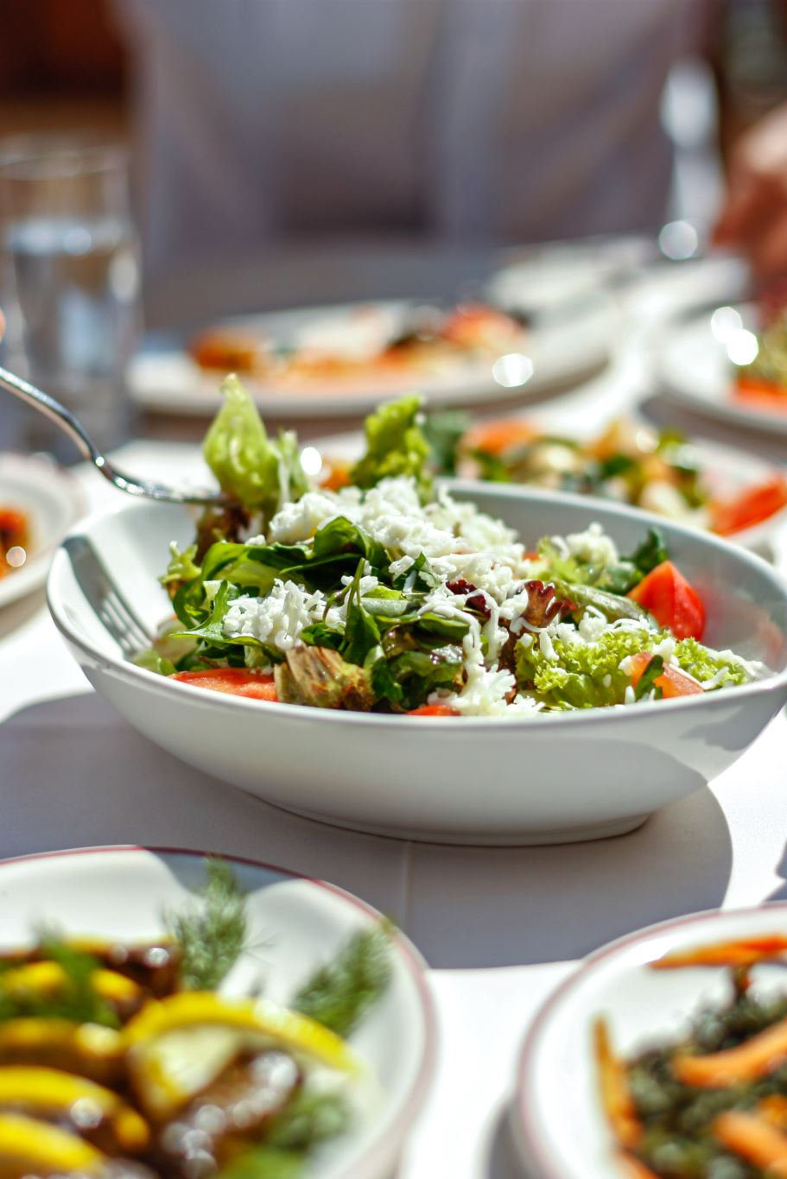
Business Background
Name: CookingWithDr
Location: Sandton, South Africa
Type: Catering Business
Services:
- Weekly Meal Preps
- Private Chef Services
- Event Catering

Slide 3
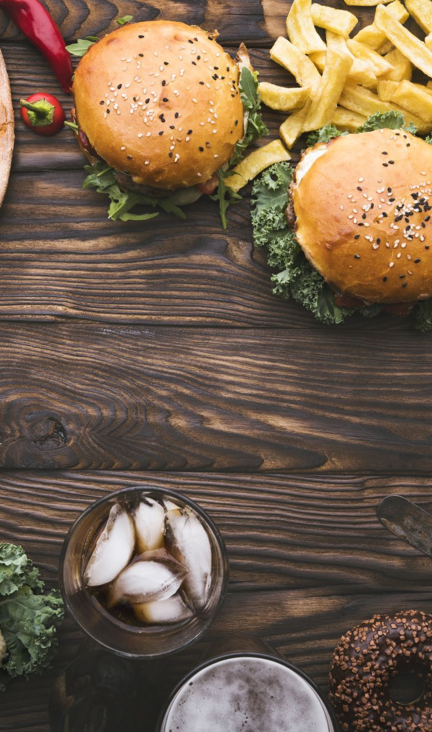
Motivation for Creating a Website
Passion for Serving Good Food
Competitive Advantage:
Few competitors have websites
Seamless quote request process
Market Conditions:
Poor service from existing catering companies

Slide 4
Website Objectives
- Improve Customer Journey
- Increase Brand Awareness & Traffic
- Boost Referrals & Reviews
- Enhance Professionalism

Slide 5
Resources Required
- Computer or Laptop
- Internet Connection
- VS Code
- Google
- Logo
- SEO Tools
- File Explorer

